Slide 1

All_India_Index_Upto_April (2023) Source: https://www.data.gov.in/ Dataset: All_India_Index_Upto_April (2023)
Indian Government Dataset Analysis
Bharadwaj Kollepara

Slide 2
Introduction
This presentation provides an analysis of the All India Index dataset, covering:
Index data for the Current Financial Year (Up to April 2023),
Index data for the Previous Financial Year (Same Month of the Previous Year),
Month-on-Month Comparison (Previous Month vs Current Month),
Year-on-Year Comparison (April 2023 vs April 2022).

Slide 3
Initial Analysis of the Dataset
Dataset Overview:
The dataset titled "All India Index Up to April 2023" presents a comprehensive record of indices related to the Indian economy, compiled up to April 2023. It primarily focuses on price indices such as Consumer Price Index (CPI), Industrial Production Index (IIP), or Wholesale Price Index (WPI), commonly used to track economic trends and inflationary patterns across India.Total Records:372
Columns: 30
Data Types:
Numerical: 4 columns (Crime counts, Serial Number)
Categorical: 3 columns (Crime categories and descriptions)
Float: 1 column (Crime counts for the previous year)

Slide 4
Dataset Overview
The All India Index Upto April 2023 dataset provides detailed information on economic indices that reflect price movements and inflation trends across India.
It includes:
Monthly index values over multiple years (up to April 2023),
Categorization by different sectors or groups (e.g., Food, Fuel, Housing, etc.),
Comparative values for current month, previous month, same month last year, and year-to-date (up to April 2023),
Insights into short-term and long-term trends in price levels and cost of living.
This dataset is instrumental for:
Tracking inflation trends,
Analyzing sectoral performance,
Supporting economic policy decisions,
Building economic reports and presentations.

Slide 5
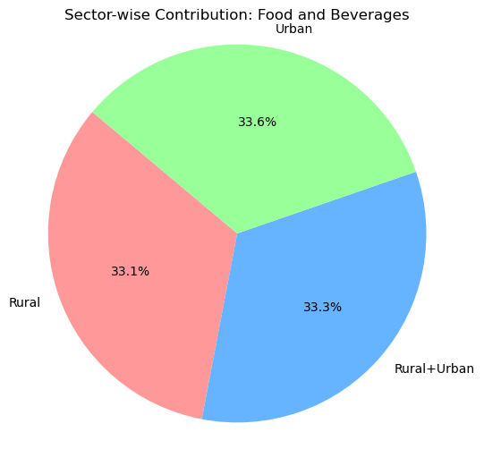
Sector-wise Contribution to Average General Index
Shows how much Food and Beverages CPI contributes across Rural, Urban, and Rural+Urban sectors.Typically, Rural sectors may have a slightly larger contribution here due to their heavier reliance on food-related consumption.

Slide 6
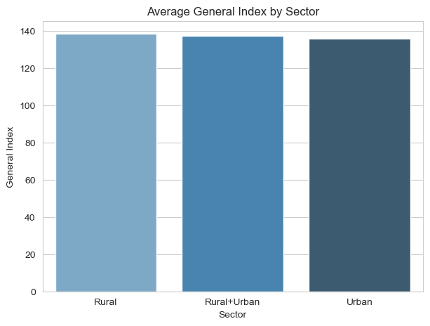
'Average General Index by Sector
A bar plot showing which sector (Rural, Urban, Rural+Urban) has the highest average General Index.Insight: Rural often trends slightly higher due to factors like food price sensitivity and seasonal variations.

Slide 7
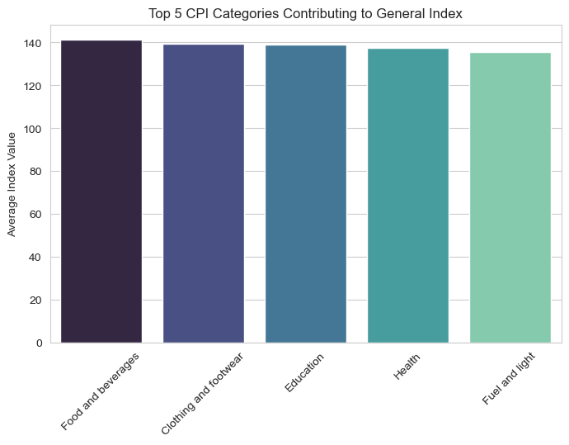
Top 5 crime categories Contributing to general Index
Highlights which 5 components contribute the most to overall inflation.Insight: Food and Beverages and Miscellaneous typically top this list.¶

Slide 8
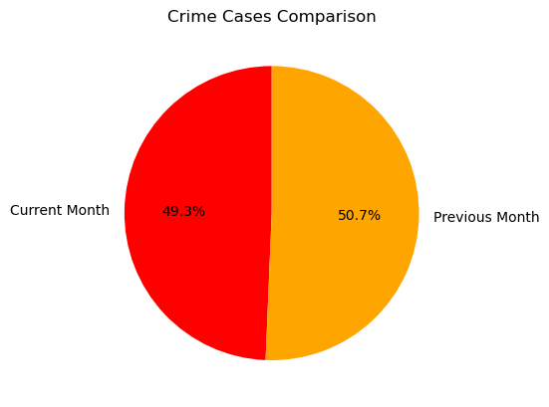
Seasonal Trend: Food and Beverages CPI
Shows the seasonal pattern of food inflation, typically rising during festive seasons or due to supply chain disruptions.¶

Slide 9
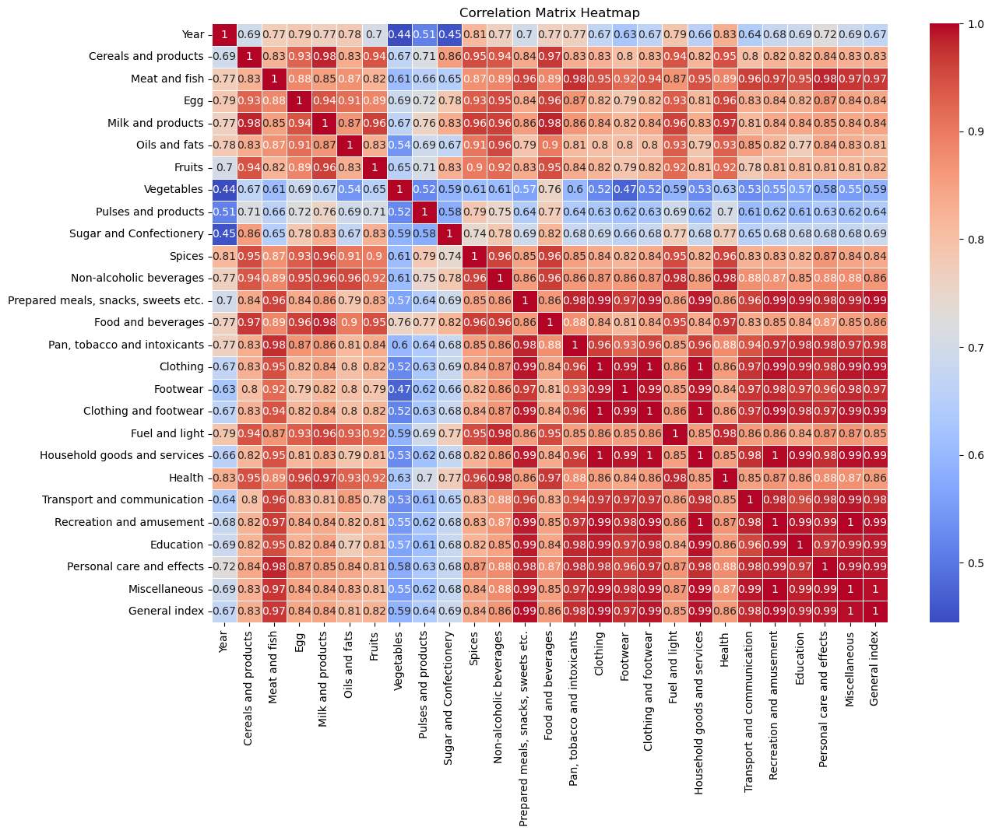
Correlation Matrix HeatmapCorrelation
Correlation heatmap Identified top 5 categories most strongly influencing the General Index:

Slide 10
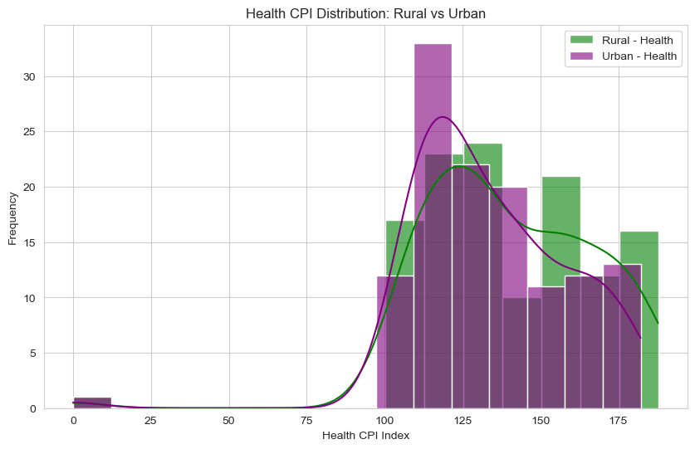
Health CPI Distribution: Rural vs Urban
Health costs CPI comparison between sectors.Insight: Urban areas might have slightly higher average indices due to healthcare service availability or pricing.
[55]:

Slide 11
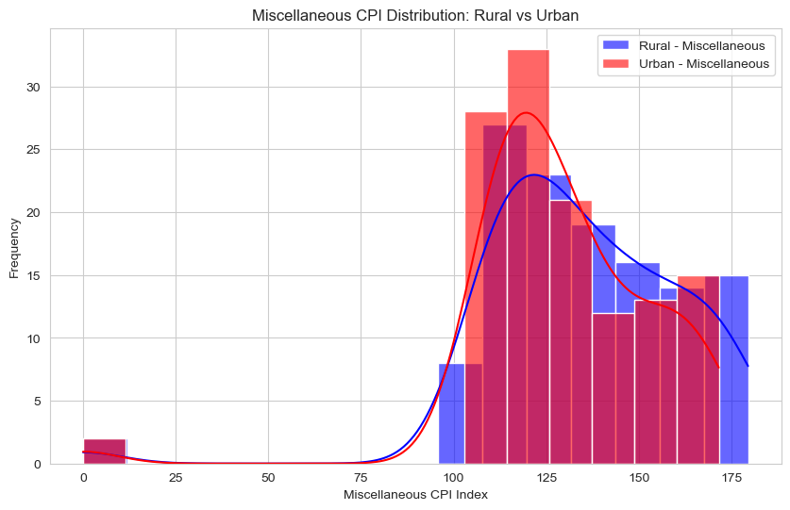
Miscellaneous CPI Distribution: Rural vs Urban
A broad CPI category reflecting discretionary spending.Insight: Rural areas might show a wider range, indicating more variation in spending patterns.

Slide 12
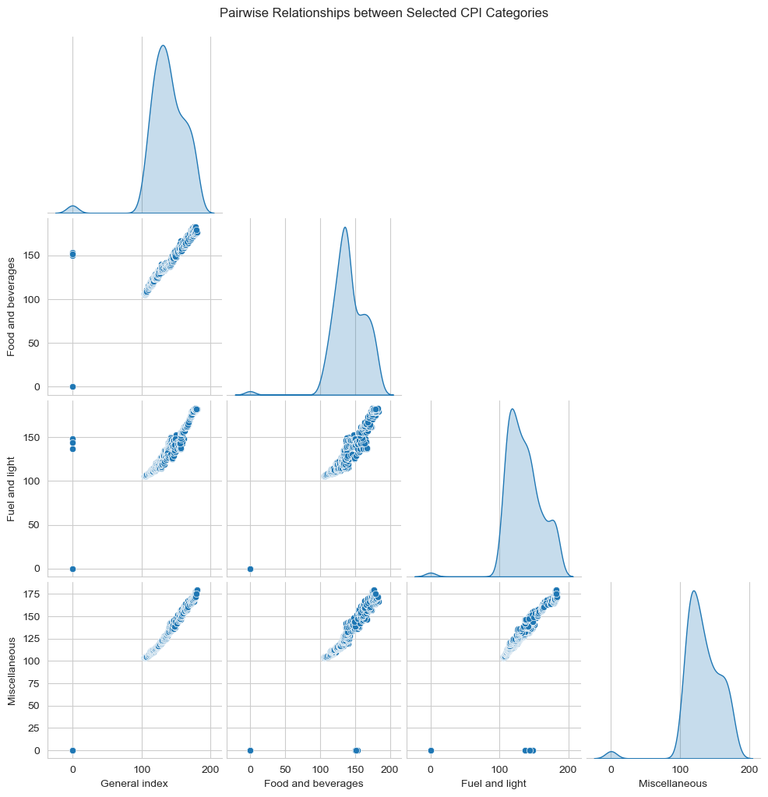
Pairwise Relationships between Selected CPI Categories
A quick way to spot trends, clusters, or relationships between selected CPI categories.

Slide 13
Conclusion
The analysis of the All India Index Upto April 2023 dataset reveals significant trends in price movements and inflation patterns across the country. By comparing index values over the current year, previous year, and across months, the dataset provides valuable insights .
These insights are crucial for policymakers, researchers, and businesses to make informed decisions related to pricing strategies, economic planning, and policy formulation.
Continued monitoring of such indices will help in anticipating future trends and responding proactively to economic challenges.

